Slide 1
Vulnerability
Analysis
Report
Presented by:- Samarth Dhol

Slide 2
TOC
Overview
Netsparker Screenshot
Executive Report
Netsparker - Detailed Report
Personal Report

Slide 3
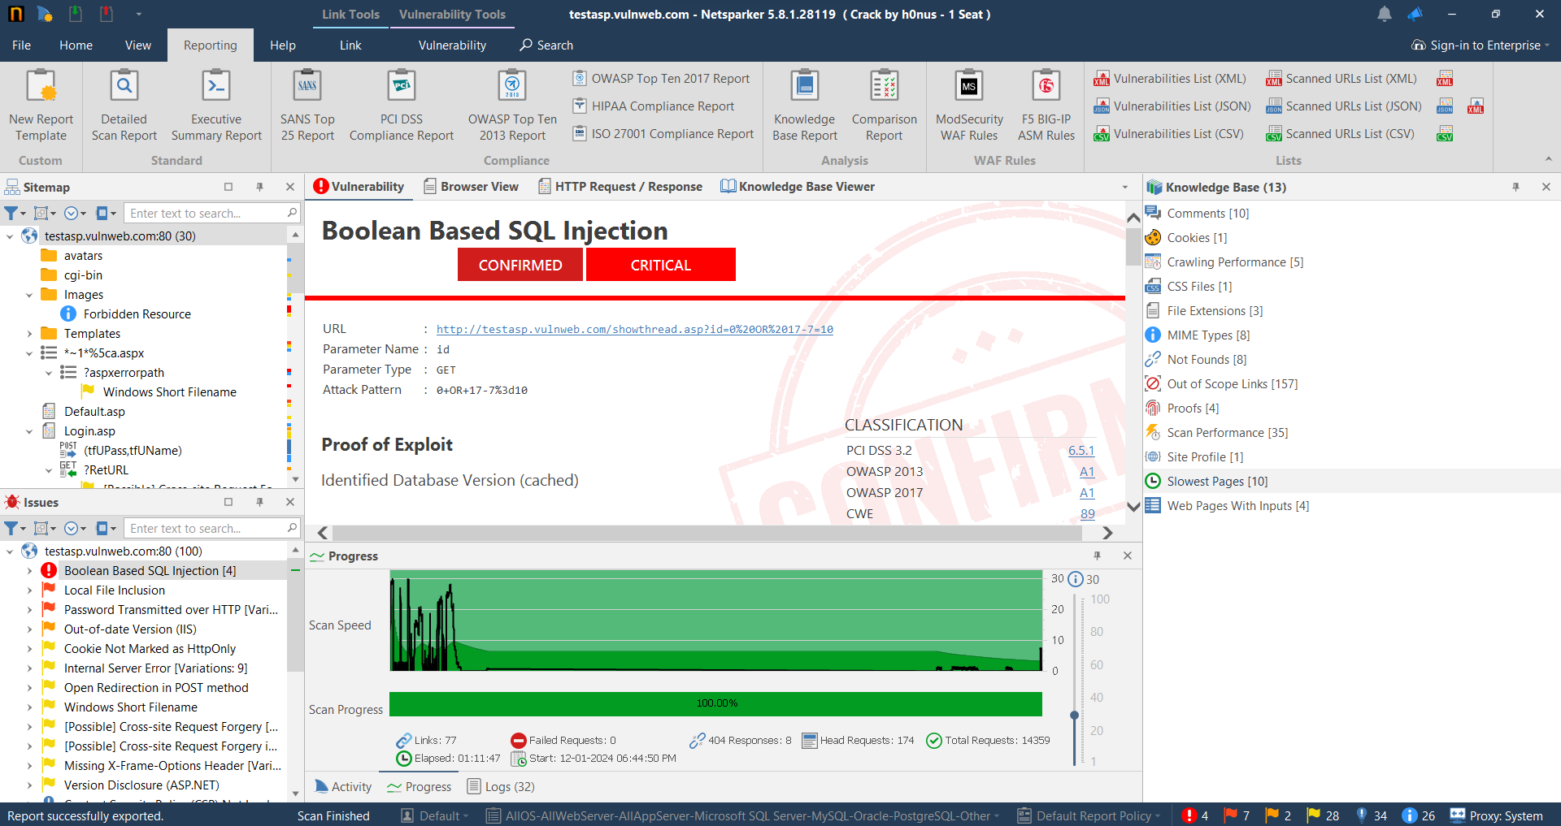
Netsparker Screenshot
Home page

Slide 4
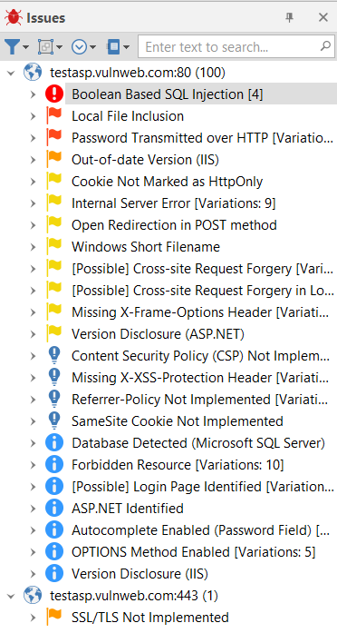
2. Issues

Slide 5
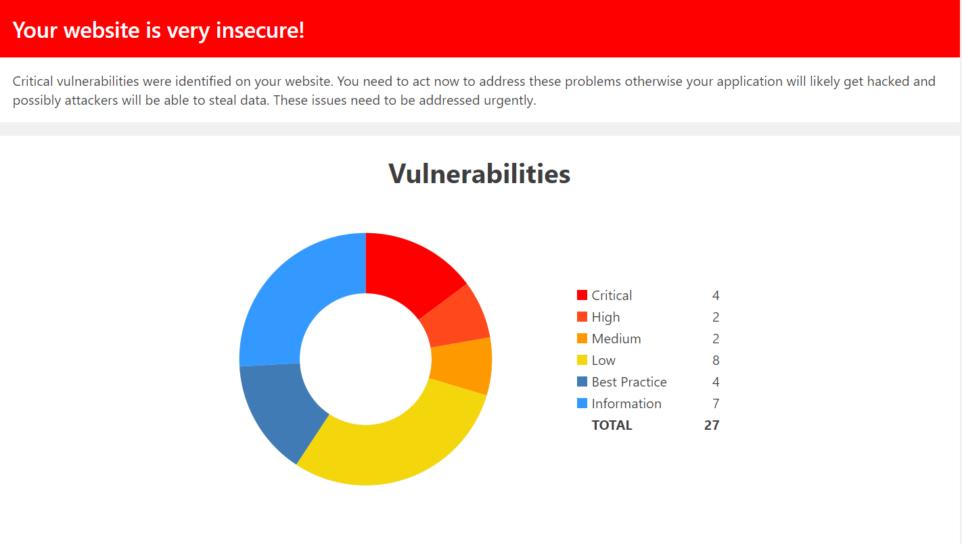
Executive Report
1.

Slide 6
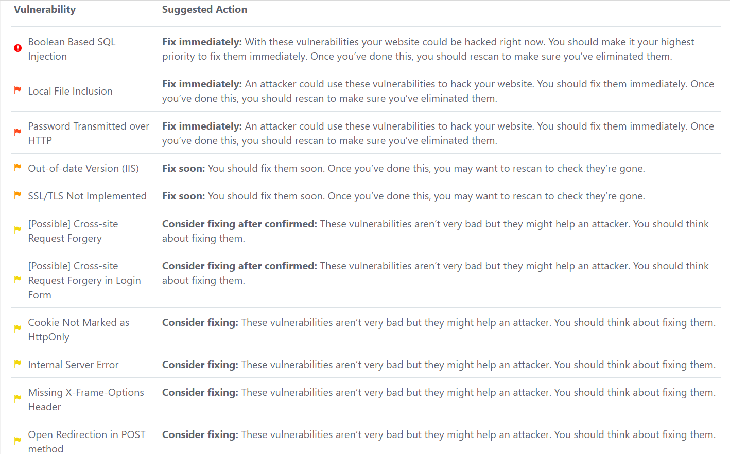
2.

Slide 7
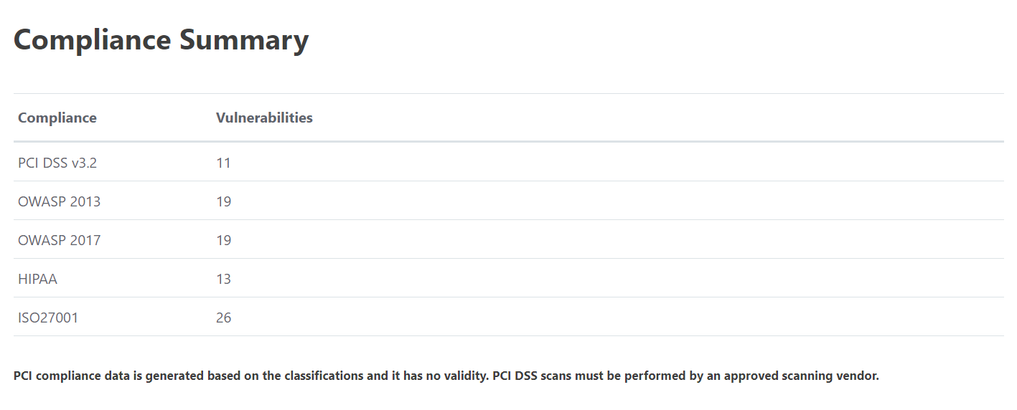
3.

Slide 8
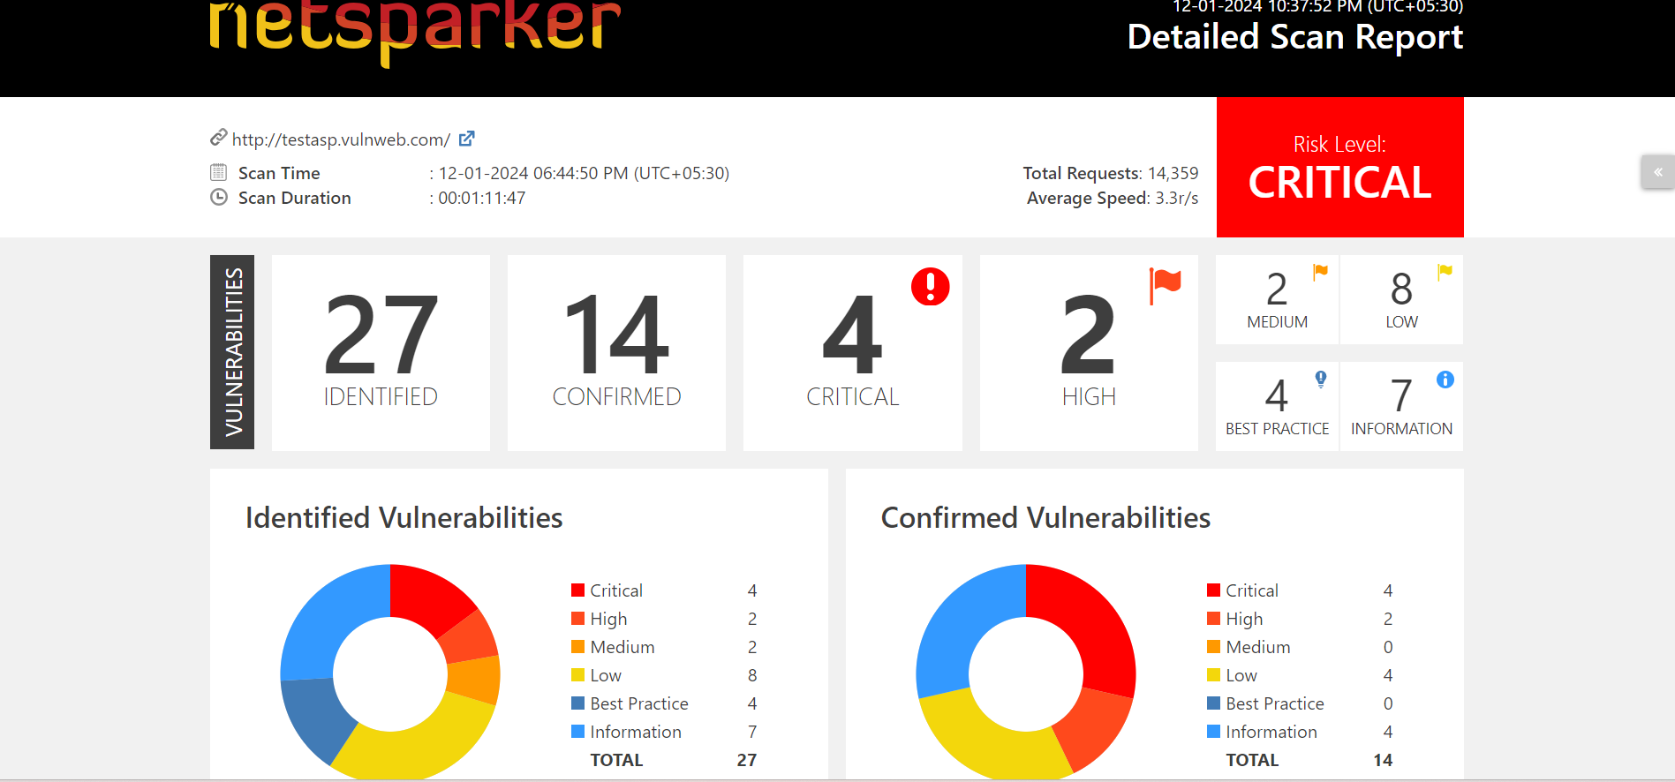
Netsparker - Detailed Report
1.

Slide 9
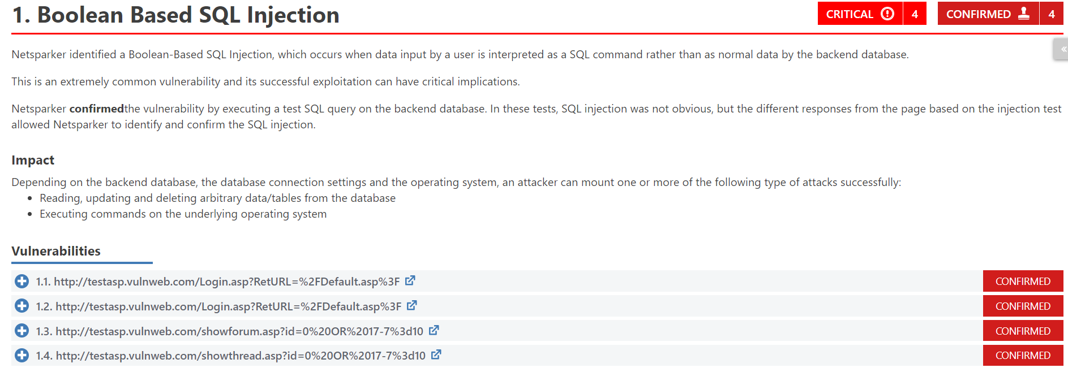
2. Vulnerability-1 (Boolean Based SQL Injection)

Slide 10
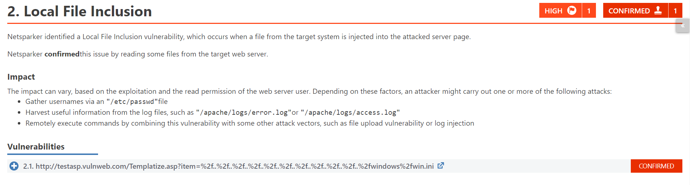
3. Vulnerability-2 (Local File Inclusion)

Slide 11
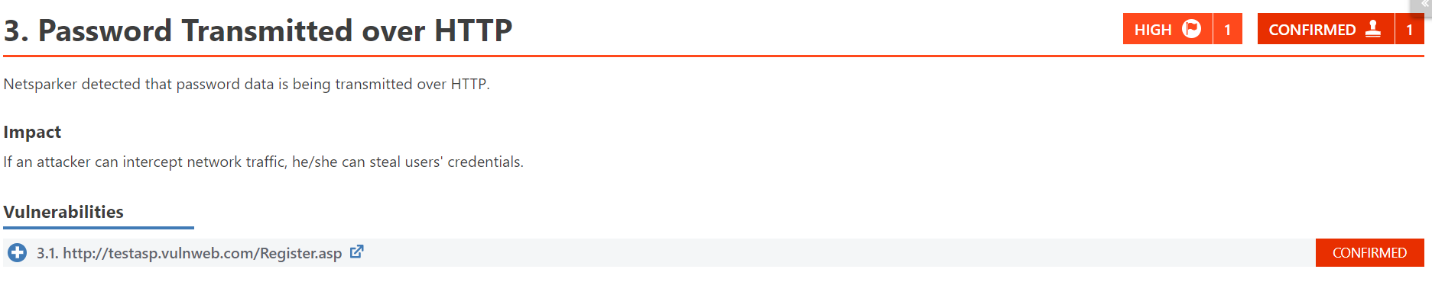
4. Vulnerability-3 (Password Transmitted over HTTP)

Slide 12
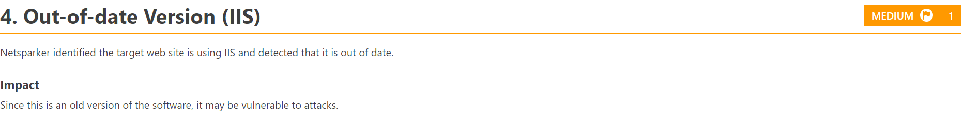
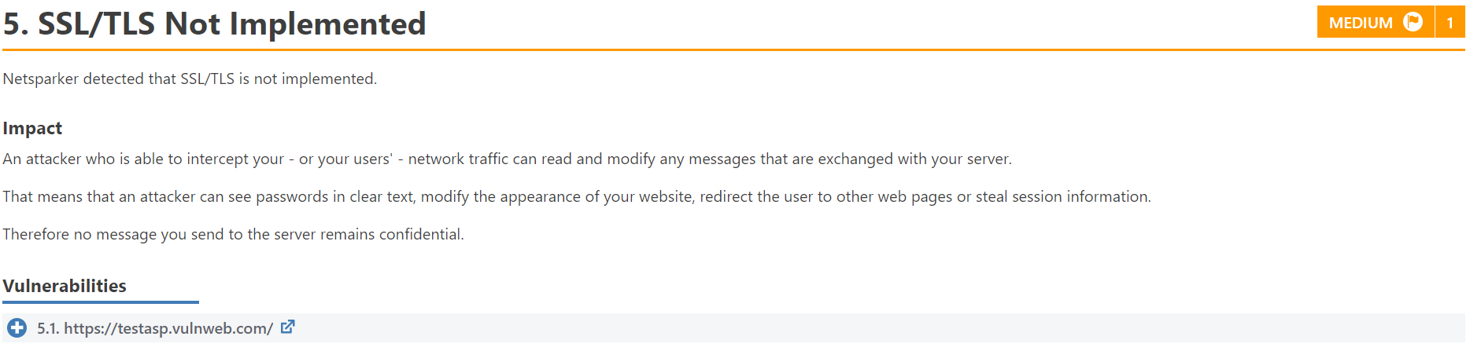
5. Vulnerability-4 (Out-of-date Version (IIS))
6. Vulnerability-5 (Out-of-date Version (IIS))

Slide 13
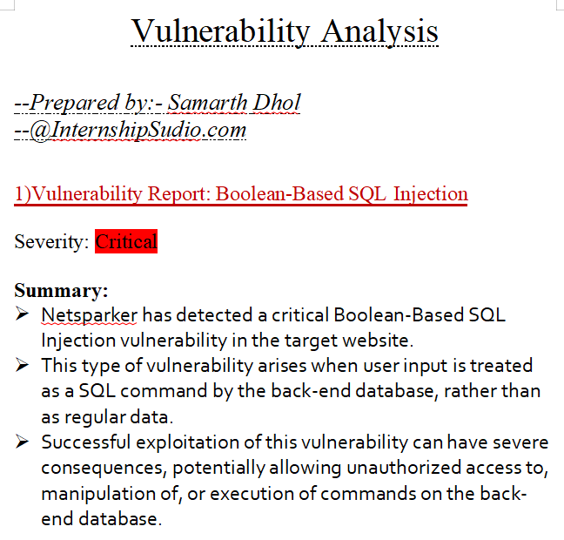
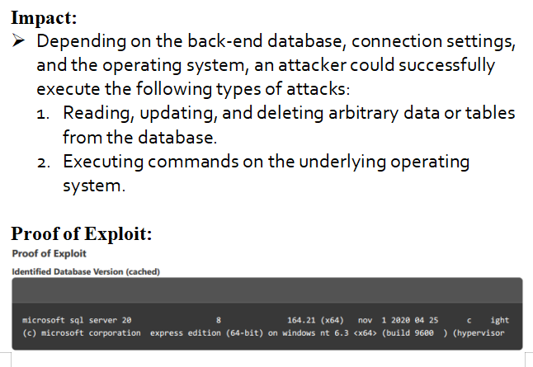
Personal Report
1.

Slide 14
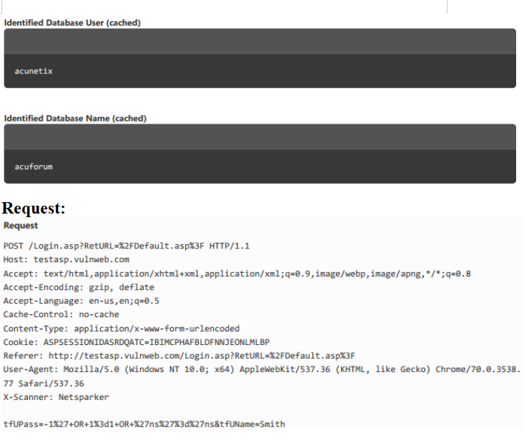
2.

Slide 15
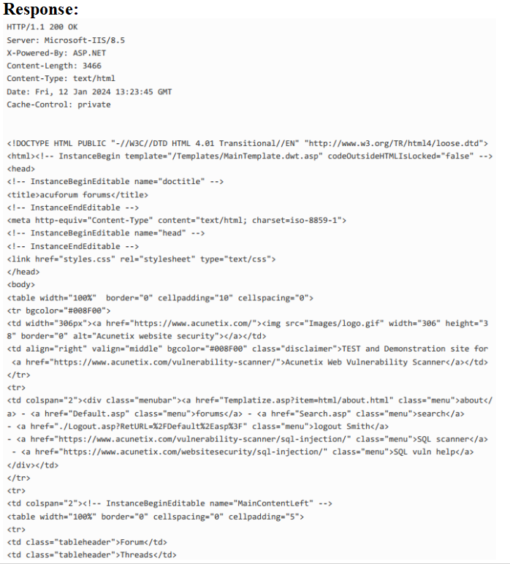
3.

Slide 16
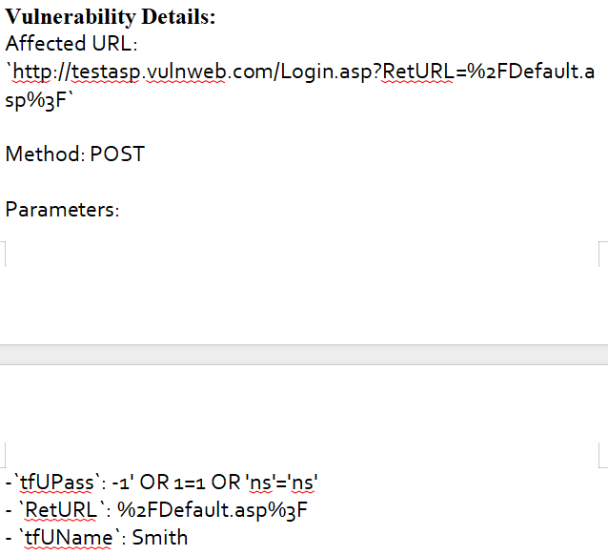
4.

Slide 17
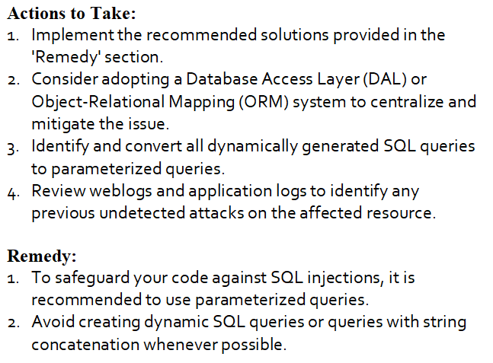
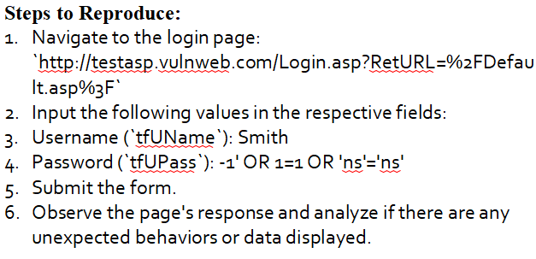
5.

Slide 18
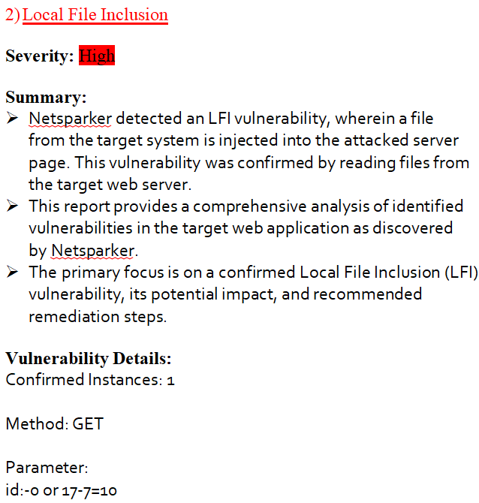
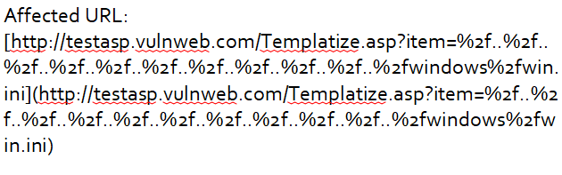
6.

Slide 19
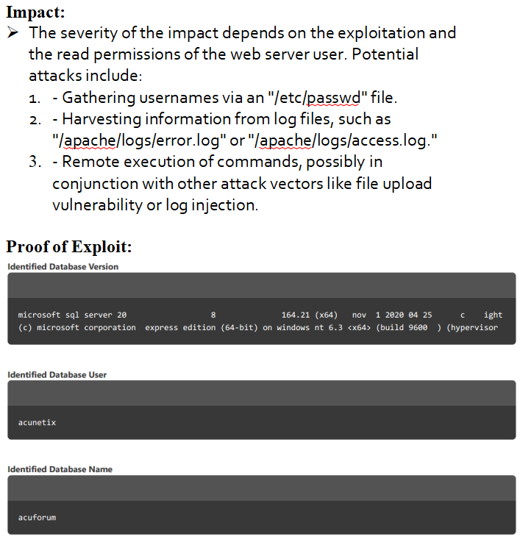
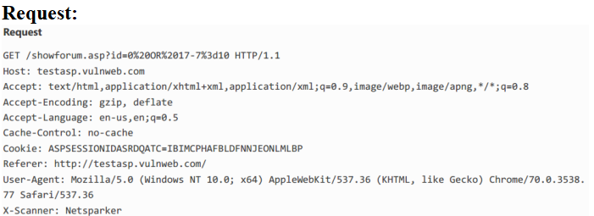
7.

Slide 20
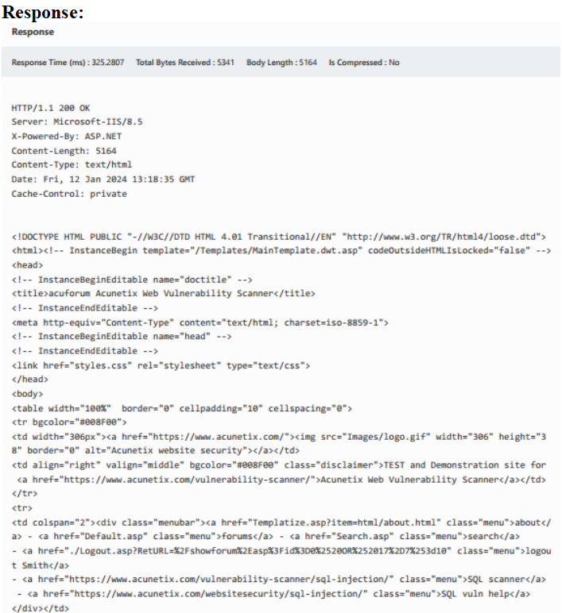
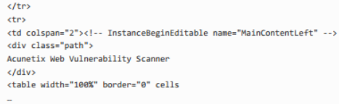
8.

Slide 21
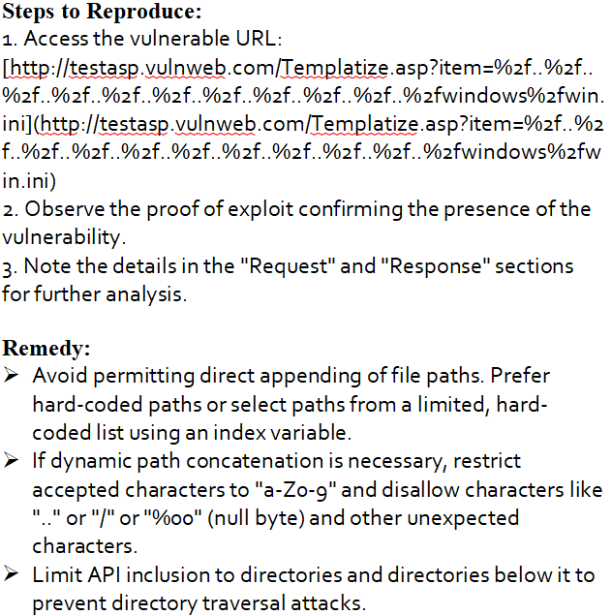
9.

Slide 22
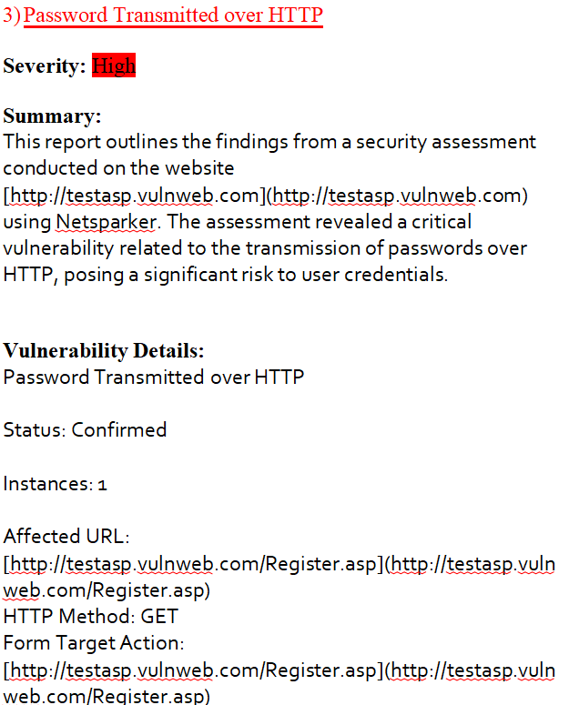
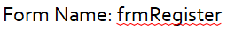
10.

Slide 23
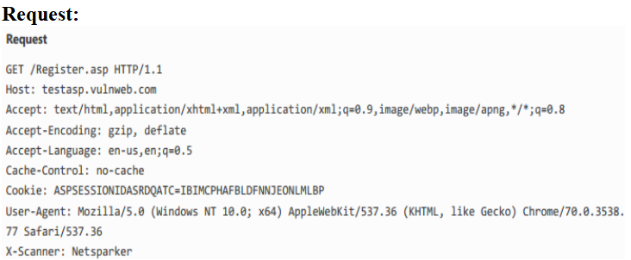
11.

Slide 24
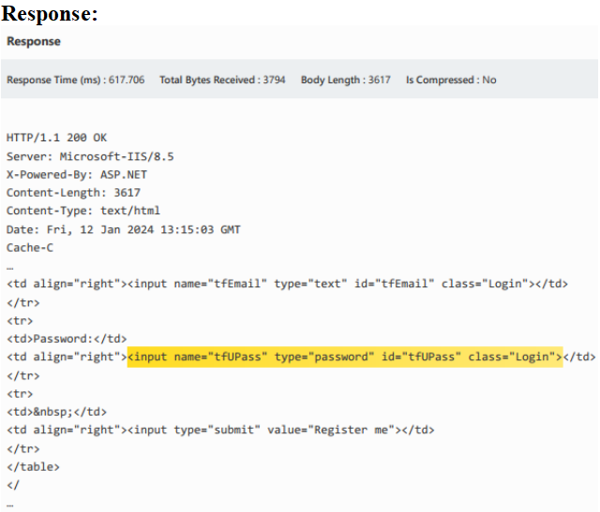
12.

Slide 25
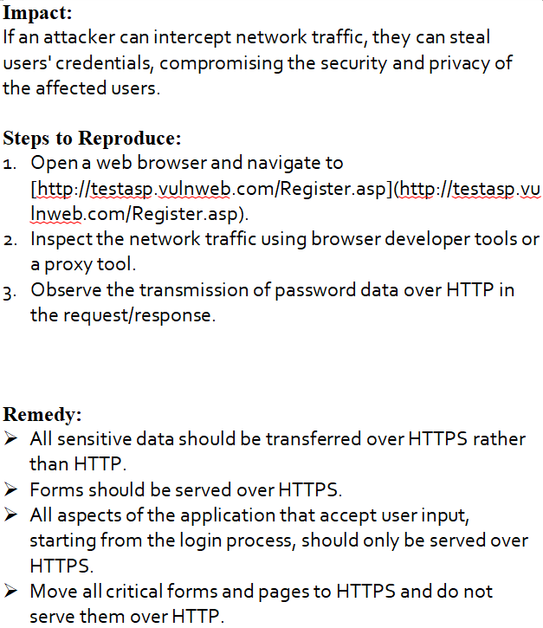
13.

Slide 26

Thank you!

